Slide 1
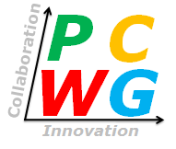
PCWG-Share-03 Launch
PCWG Meeting Hamburg
Peter Stuart (RES) & Paul Housley (SSE)

Slide 2
Recap

Slide 3
PCWG-Share-X: Objective
We Want to:
Examine bias errors and uncertainties of methods for predicting wind turbine performance in outer range conditions.
Determine the optimum methods across many datasets.
By:
Sharing experiences of how methods perform across organisations using a consistent tool.
And:
Avoiding the sensitivities that would normally inhibit organisations sharing data.
And:
Making it quick and easy for organisations to participate.

Slide 4
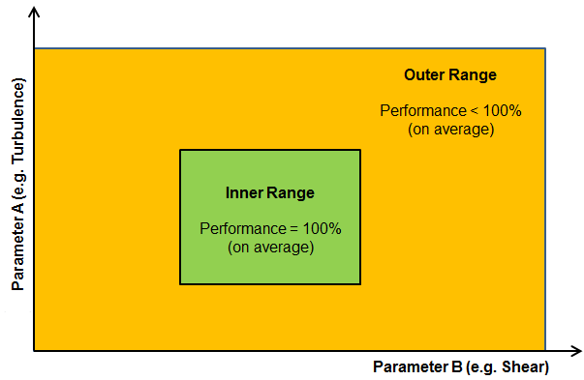
Inner And Outer Range Concept
Outer Range
Inner Range
The PCWG Inner-Outer Range Proposal is Conceptual Decomposition, and does not infer specific parameter ranges.

Slide 5
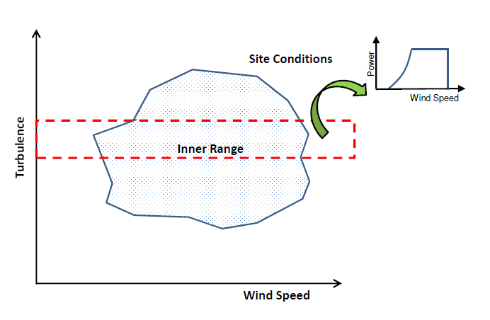
PCWG-Share-X: Neutralising Commercial Sensitivities
Inner Range Power Curves Extracted from the Dataset Itself:
Warranted/sales power curve not used
Power curve extracted from inner range (tested in outer range)
Intelligence Sharing, not Data Sharing:
Share highly anonymised performance metrics of correction methods (not raw data shared)
Test
Test

Slide 6
PCWG-Share-X: Data Flow
Hypothesis/Trial Methodology
Analysis Definition Y
Analysis Definition Y
Analysis Definition Y
Analysis Definition Y
Proprietary Dataset A
Proprietary Dataset B
Proprietary Dataset C
Proprietary Dataset D
Organization A
Organization B
Organization C
Organization D
Hypothesis Performance Metrics
Aggregator
(NREL)
Combination Analysis
How well did the trial method perform?
Aggregated Hypothesis Performance Metrics
Discuss outcome at PCWG Meetings

Slide 7
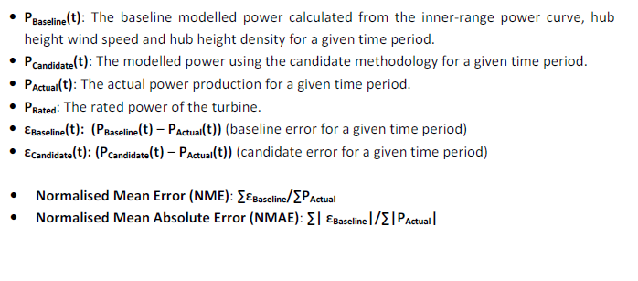
PCWG-Share-X: Error Metric Definitions
How we test the accuracy of correction methods
0 if ‘right on average’
0 if ‘right all the time’
See PCWG-Share-X Definition Document for Further Details
Download PCWG-Share-X Definition Doc from www.pcwg.prg

Slide 8
Progress to Date
PCWG-Share-1 (winter 2015)
Initial roll-out: tool teething and usability issues.
Some unexpected results when ‘round-tripping’ inner range power curve (‘baseline errors’)
PCWG-Share-1.1 (autumn 2016)
New interpolation method to eliminate baseline errors (Marmander/Albers).
Correction of bug causing large baseline errors for around 1 in 10 datasets.
PCWG-Share-2 (summer 2017)
Much improved tool usability:
Moved turbine parameters (hub, diameter etc) into dataset object.
One-click participation (for existing participants)
More methods tested.
Bug impacting Matrix Results (more later)
PCWG-Share-3 (launching mid-Fib 2018)
Much improved tool usability.
Matrix Bug Fix
More methods tested.
Extensive/comprehensive numerical testing.
Optional Enhanced Data Sharing Submission

Slide 9
PCWG-Share-02 Results Recap
Methods under test
IEC Turbulence Correction
REWS (Speed, Veer & Upflow) - REWS (S, V & U)
RAWS (Speed, Veer & Upflow) - RAWS (S, V & U)
2D Power Deviation Matrix
3D Power Deviation Matrix
Production by Height (Dan Bernadette AWS True Power)

Slide 10
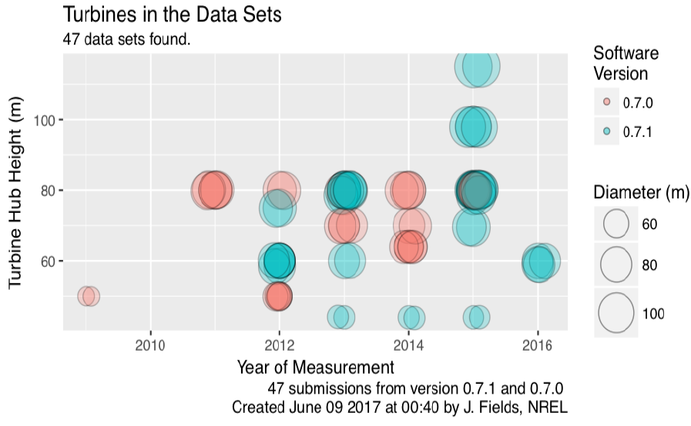
PCWG-Share-02: Turbine Size vs Measurement Year

Slide 11
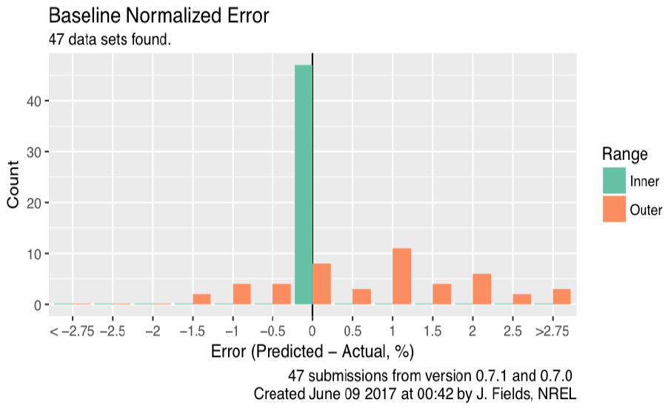
PCWG-Share-02: Baseline Error, Inner vs Outer Range
Inner Range baseline errors are all close to zero (self-consistent)
Spread of Outer Range Results representative of Outer Range Modelling Uncertainty.
Shift to RHS indicative of outer range bias

Slide 12
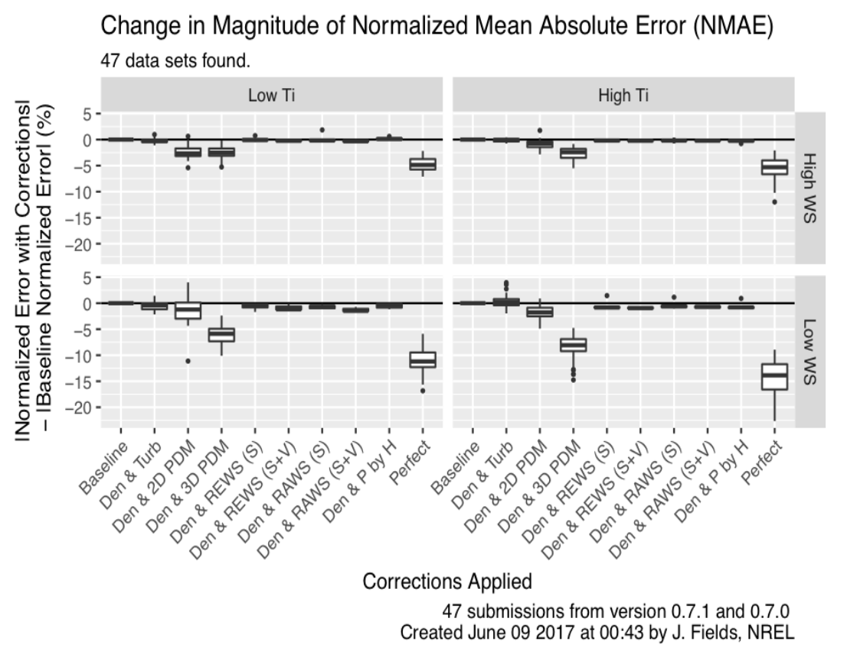
PCWG-Share-02: Errors by Method (‘Four Cell Matrix’)
v
Q. Large improvement for matrix methods: too good to be true?
A. Yes, unfortunately (software bug)
Improvement

Slide 13
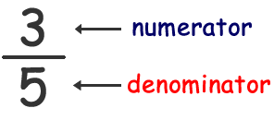
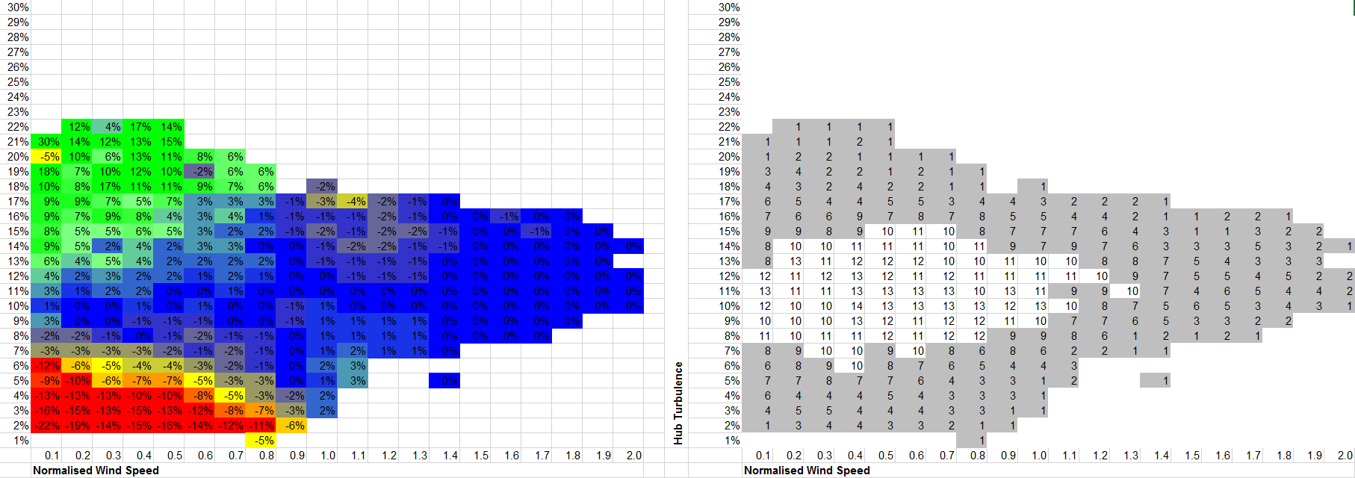
PCWG-Share-X Matrix Method Bug
Impact of bug: benefit of 2D matrix methods was overstating.
Cause:
Time series data points for matrix cells below data count threshold (NaN values) were removed from the numerator, but the baseline values were left in the denomintator.
Errors of matrix methods understated (benefit overstated)

Slide 14
PCWG-Share-02 Bug Lessons Learnt
Implementation of comprehensive end-to-end excel tests for all PCWG-Share-X methods.
Excel tests prepared by Paul Housley & Peter Stuart
Tests/benchmarks will be made publicly available on pcwg.org.
Time-coming, but very valuable process.
No other material bugs (other than known matrix bug) discovered by testing.
Changes to future practice:
Don’t rush out PCWG tool releases.
New Process: Two gateways now defined:
End-to-end numeric testing of all methods (prior to beta testing)
Usability Testing by Beta Testing Group (prior to release)

Slide 15
PCWG-Share-03
Beta Testing Start: week commencing 5th of Feb
Planned Tool Release & PCWG Start mid Feb
New Methods
Empirical Turbulence Correction
Modified version of IEC Turbulence Correction
+ all other previous methods
Other Tool Improvements
Range Specific Matrices
Minor improvements to IEC Zero Turbulence Curve Calc
Hermite Interpolation (in place of Cubic Spline)

Slide 16
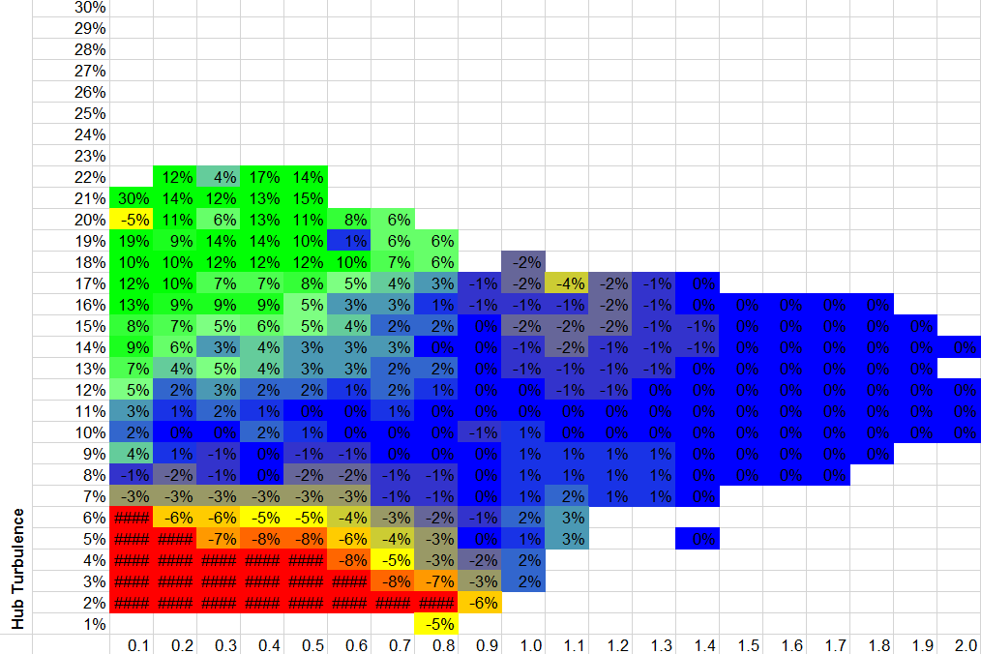
Range Specific Matrices (A)

Slide 17
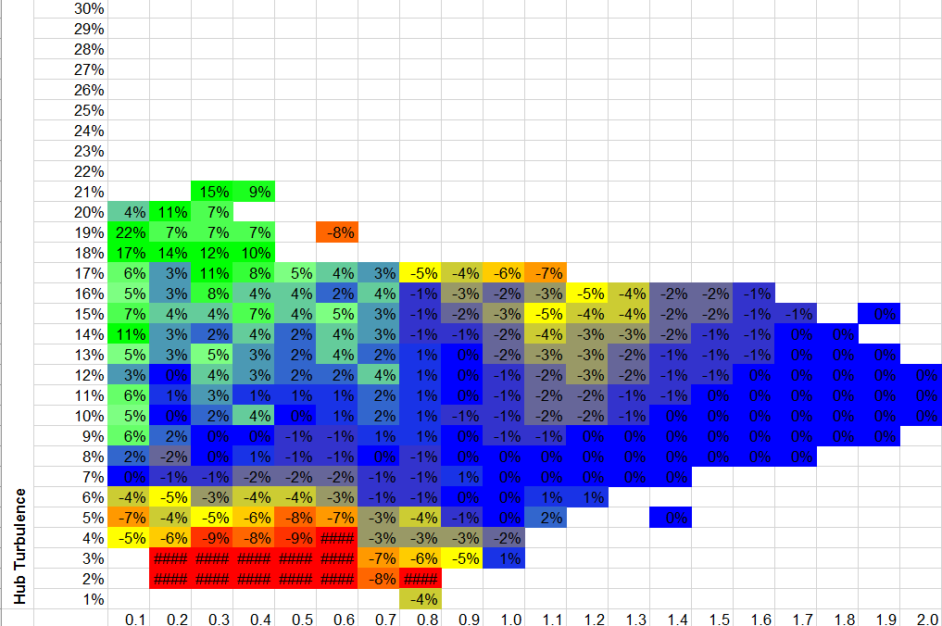
Range Specific Matrices (B)

Slide 18
Join the Power Curve Working Group at: www.pcwg.org

